Slide 1
P²Net:Patch-match and Plane-regularization for Unsupervised Indoor Depth Estimation

Slide 2
Unsupervised depth estimation
Extract discriminative keypoints with large local gradients and use patches centered at each point as its representation
patch-match: A patch-based warping process that assumes the same depth for pixels within a local patch is proposed for a more robust matching.
plane- regularization: we propose to use superpixels to represent those homogeneous-texture or non-texture piecewise planar regions and regularize the depth consistency within each superpixel.
This approach is most suitable for indoor scene depth estimation

Slide 3
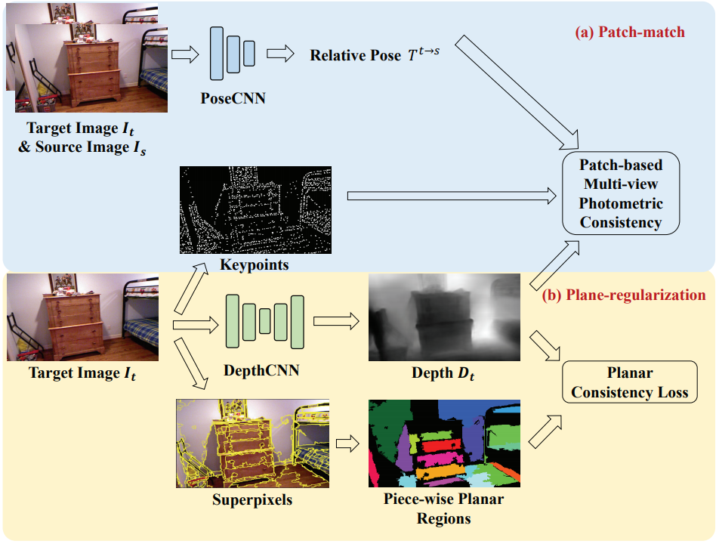
Method
The P²Net contains of the following modules:
Two learnable modules:
Depth CNN
Pose CNN
Patch-match Module
Plane-regularization Module
Overall network architecture of the P²Net

Slide 4
Keypoint Extraction
Here, we adopt the points selection strategy from Direct Sparse Odometry (DSO) for its effectiveness and efficiency. Points from DSO are sampled from pixels that have large intensity gradients.
The benefit of doing this is we don’t need to precompute the matching across images which is a challenging task.
Our points need to be extracted from the target image only once and no handcrafted descriptor for matching is needed.

Slide 5
Patch based multiview photometric consistency error

Slide 6
Planar Consistency Loss
We assume that most of the homogeneous color regions are planar regions.
We assume a continuous depth that satisfies the planar assumptions within these regions.
Following representative work on reconstruction of indoor scenes, we adopt the Felzenszwalb superpixel segmentation in our approach. The segmentation algorithm follows a greedy approach and segments areas with low gradients, and hence produces more planar regions.
Given an input image I, we first extract superpixels from the image and only keep regions larger than 1000 pixels.
Given an extracted superpixel SPPm and its corresponding depth D(pn) from an image, where pn enumerates all the pixels within SPPm, we first backproject all the points pn back to 3D space,

Slide 7
Loss Function

Slide 8
Superpixels - algorithms
To generate superpixels, we evaluate the following 2 algorithms :
SLIC
Felzenszwalb (used in the paper)
We vary the hyperparameters and evaluate the results qualitatively.

Slide 9
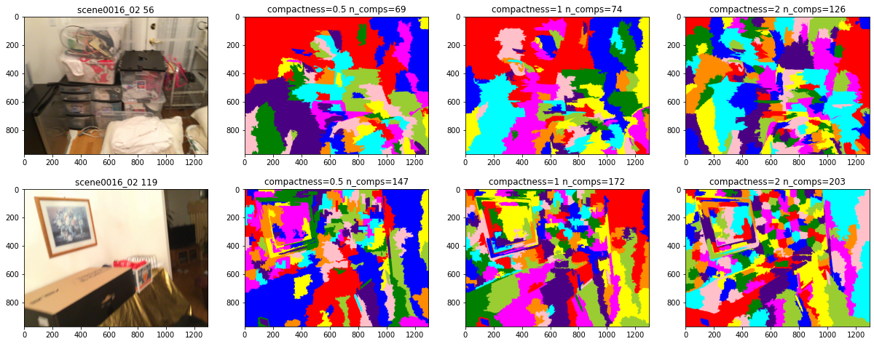
Superpixels - SLIC
Number of segments - 500

Slide 10
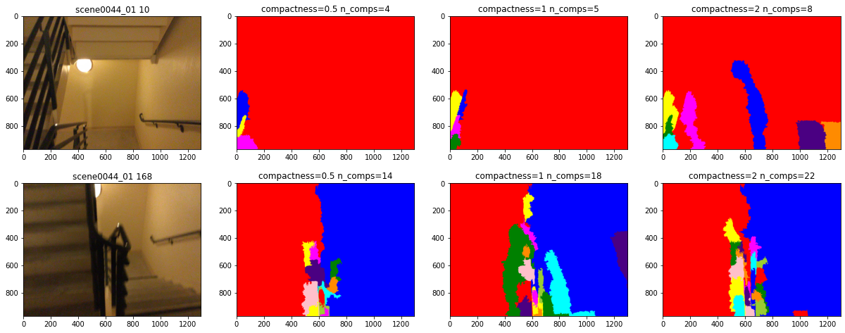
Superpixels - SLIC
Number of segments - 500

Slide 11
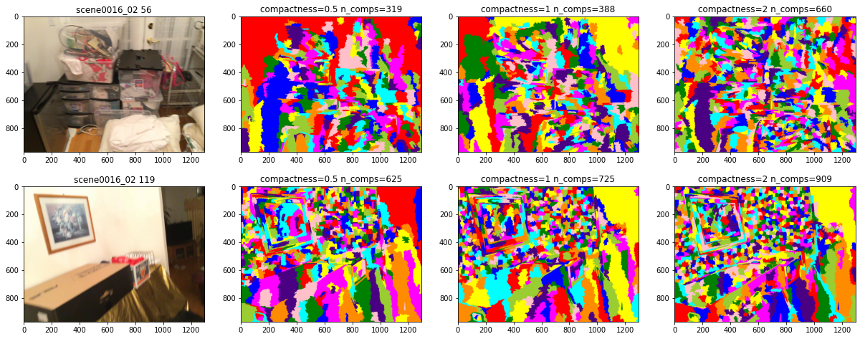
Superpixels - SLIC
Number of segments - 2000

Slide 12
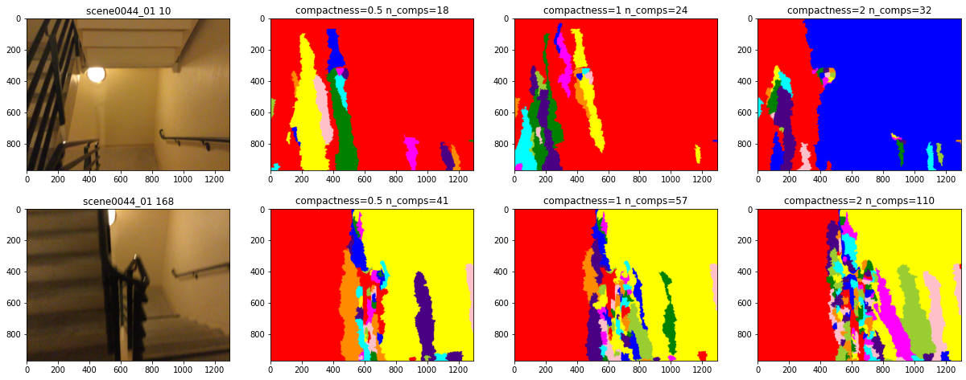
Superpixels - SLIC
Number of segments - 2000

Slide 13
Superpixels - SLIC
The previous results highlight the shortcomings of SLIC:
The generated superpixels capture the textureless regions in either extremely dense or sparse manner.
The generated superpixels do align themselves along the planar surfaces and ,hence, are not useful for enforcing the planarity constraints.

Slide 14
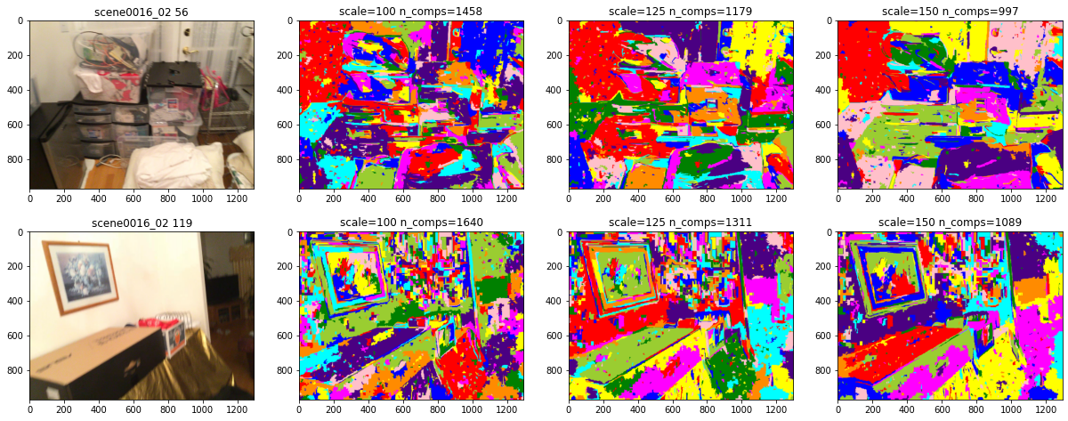
Superpixels - Felzenszwalb
Varying scale parameter

Slide 15
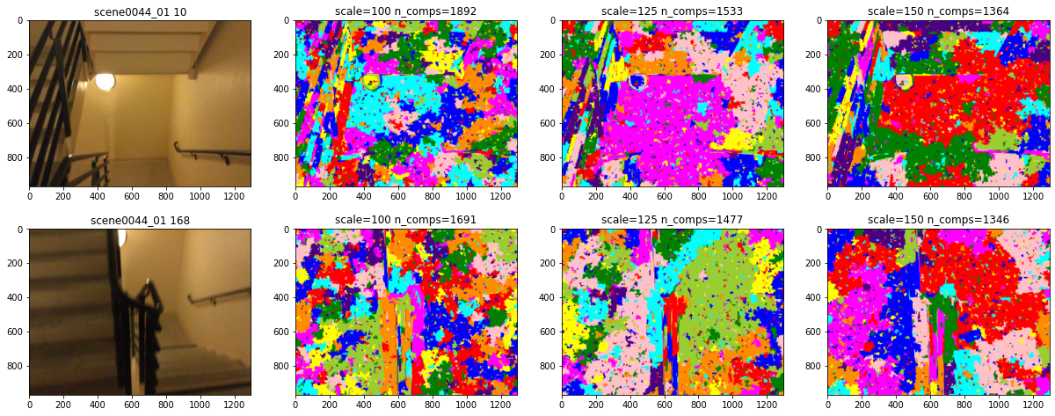
Superpixels - Felzenszwalb
Varying scale parameter

Slide 16
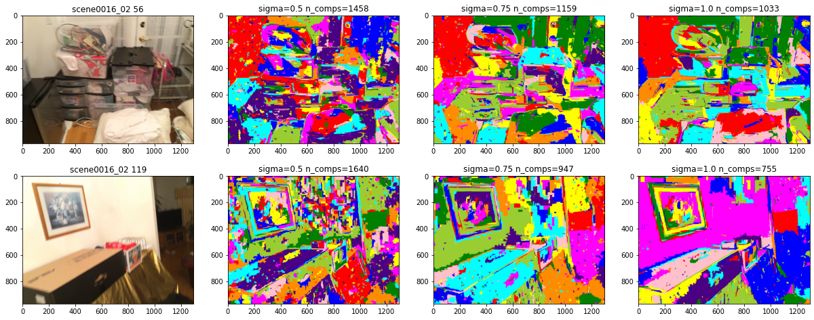
Superpixels - Felzenszwalb
Varying sigma parameter

Slide 17
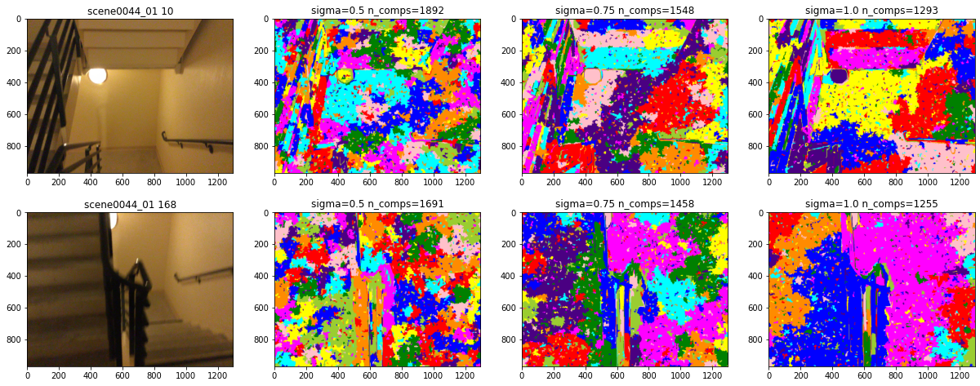
Superpixels - Felzenszwalb
Varying sigma parameter

Slide 18
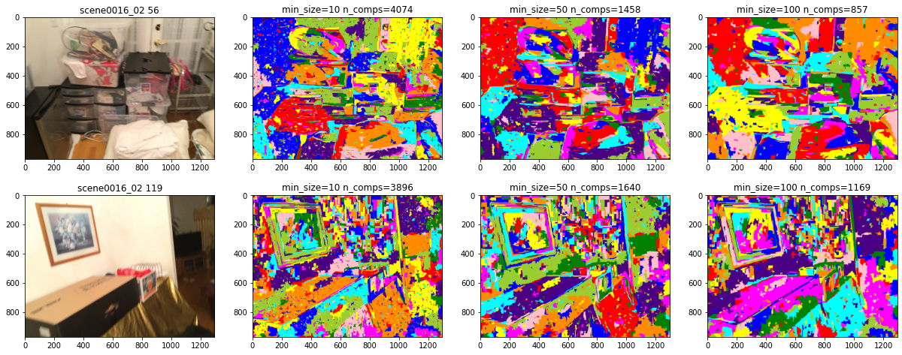
Superpixels - Felzenszwalb
Varying min_size parameter

Slide 19
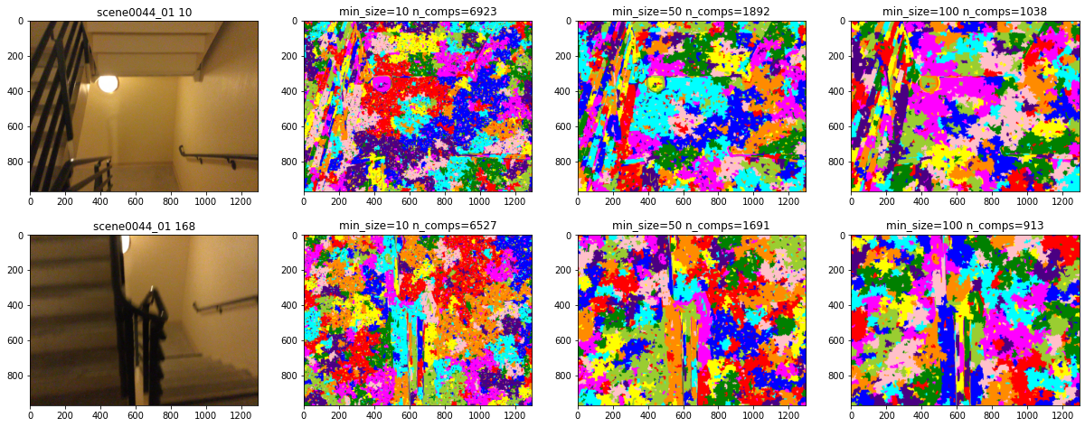
Superpixels - Felzenszwalb
Varying min_size parameter

Slide 20
Superpixels - Felzenszwalb
The previous results highlight the following advantages of Felzenszwalb:
The generated superpixels are generated much more evenly in textureless regions across images.
The superpixels are also aligned along the surfaces.
There are also shortcomings of this algorithm:
In textureless regions, the superpixels are still overly fragmented and noisy.
The superpixels sometimes span across two surfaces over an edge, such as walls, if they have very similar textures. This will be problematic since it will force the two surfaces to be planar and lead to incorrect supervision.

Slide 21
Experiments
We train the following 4 models for our experiments:
Base Model - based on Monodepthv2
Sparse Keypoints - Using patch match but keeping the number of keypoints <= 100.
No Planar Constraint - Using dense patch match on 3000 keypoints but not enforcing any superpixel based planarity constraint.
Indoor SFM - Using dense patch match along with superpixels planarity constraint.
In addition to the above, we also use a pre-trained MiDaS model for evaluation since it was covered as part of the course.

Slide 22
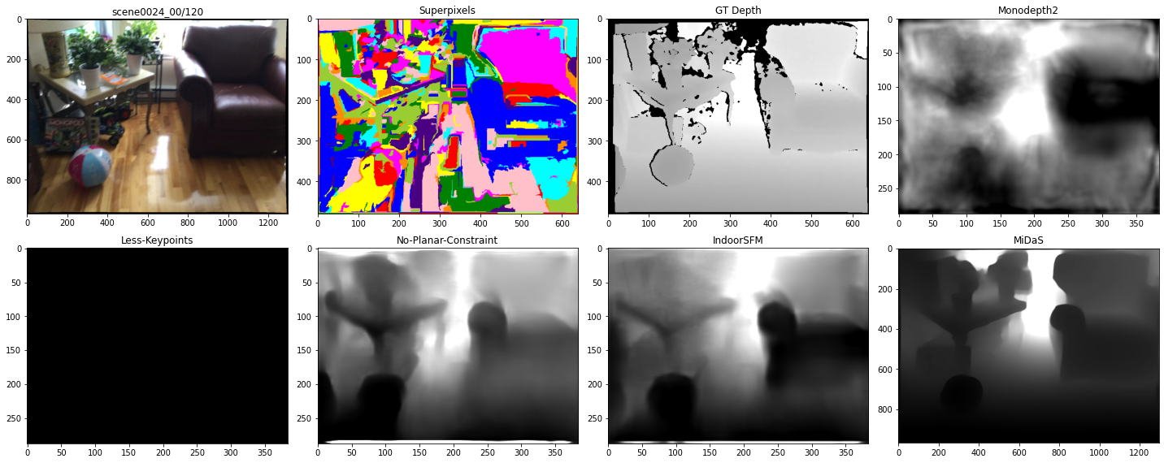
Results

Slide 23
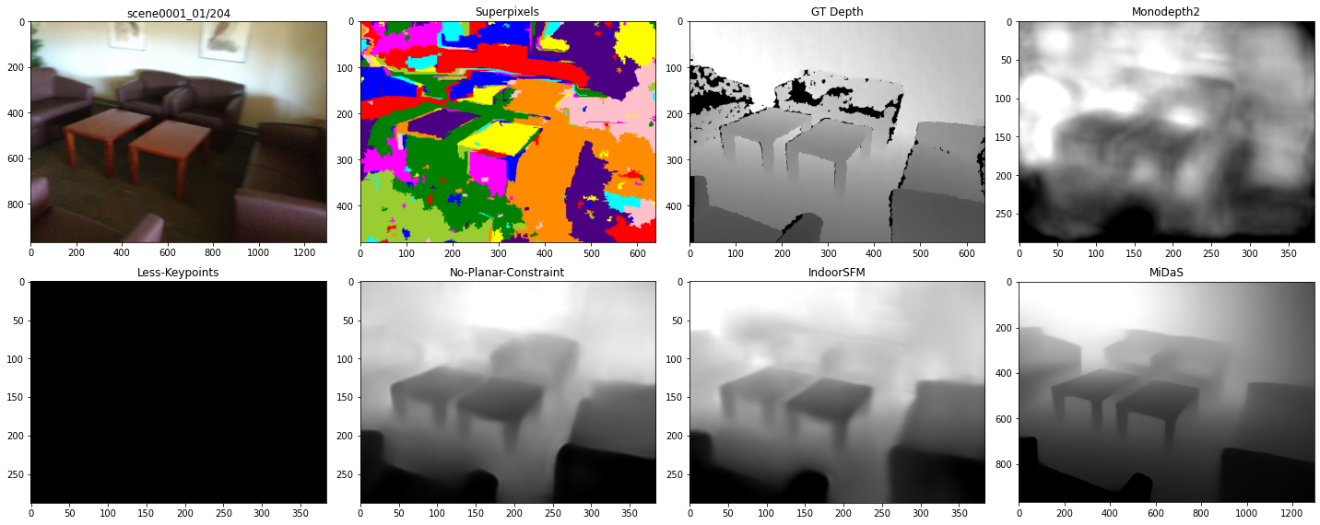
Results

Slide 24
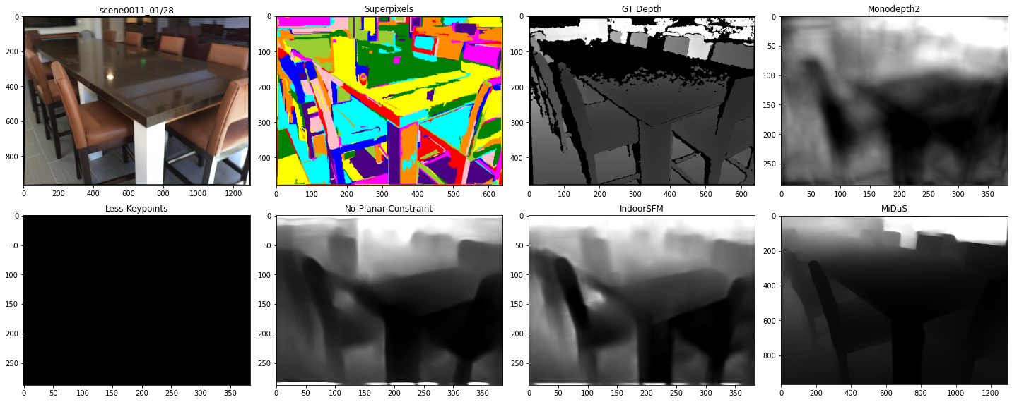
Results

